Slide 1
Nalco’s Corn Oil Separation Aid
Increase Recovery + Decrease Variability

Slide 2
Increase yield by up to .3 lb / bushel

Slide 3
Decrease extraction system variability

Slide 4
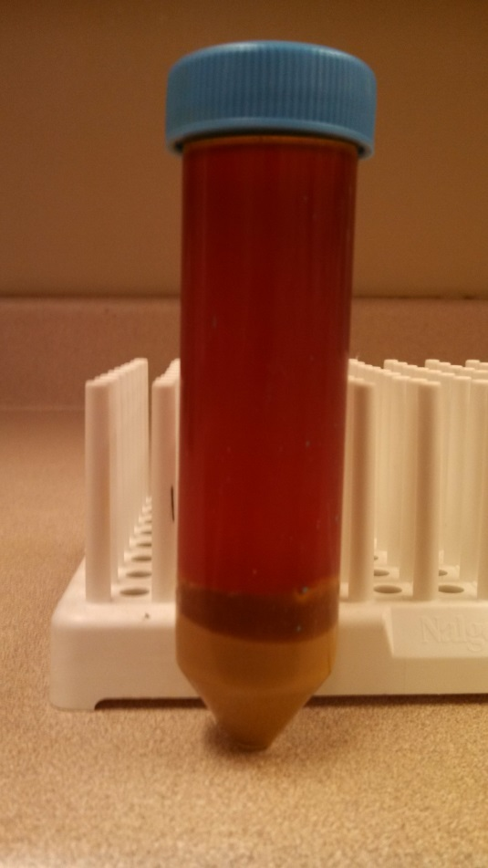
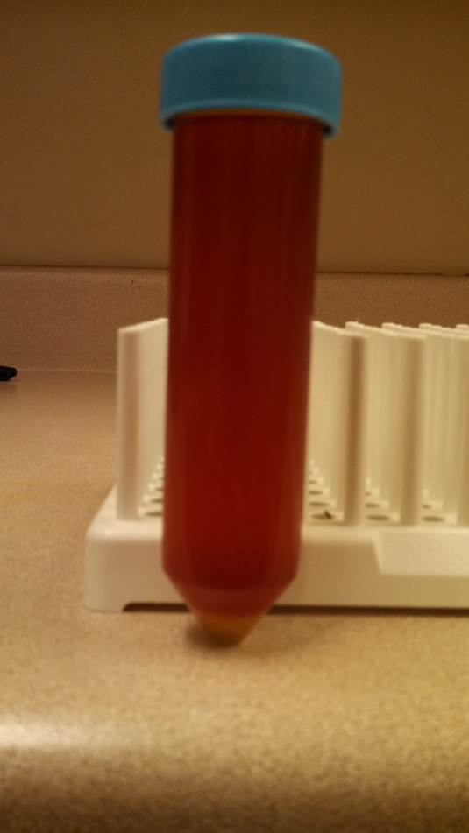
Crude Corn Oil Quality is Significantly Improved
Before
After

